Slide 1
Software Systems Architecture
Xiaobin Xu
doublexb@163.com
Software Systems Architecture
Xiaobin Xu
1

Slide 2
Module 1: Software Systems Architecture basics
Content:
History of Software Development
Definition of Software Architecture
Some Related Concepts of Software Systems Architecture
Where do architectures come from?
Values of Software Architecture
Current Research & Practicing in Software Systems Architecture

Slide 3
History of Software Development
Assemble Language
Small size of program
1970’ ►
Advanced Language
Structure-Oriented Theory
Dataflow/Control flow Design Methods
1980’ ►
Application Development Library: Class/Functions Library
Object-Oriented Theory
Object Modeling & Design Technology
1995 ►
Application Development Framework: J2EE, .NET
Component Technology: COM/DCOM, CORBA …
Object Modeling & Design Standardization: UML
Future ►
Model-Driven Development: MDA
……
Software Systems Architecture
Xiaobin Xu
11

Slide 4
History of Software Development
Review of the history of the software:
The size and the complexity of software is becoming larger and more complex.
The application areas of software: science computing,
manufacturing, commerce, education and amusement.
The abstraction level of software is becoming
more high.
Machine Language－>Assemble Language－>Advanced Language－> Application Framework
Structure-Oriented Programming －> Object-Oriented Programming－> Aspect-Oriented Programming
Software Systems Architecture
Xiaobin Xu
12

Slide 5
History of Software Development
Results of the development of software:
Good architecture design has always been a major factor in determining the success of a software system .
The architecture and designing is more important than the data structure and the program algorithm.
Software Systems Architecture
Xiaobin Xu
13

Slide 6

The Definition of SA
Can be built by one person Requires
Minimal modeling Simple process Simple tools
Software Systems Architecture
Xiaobin Xu
14

Slide 7
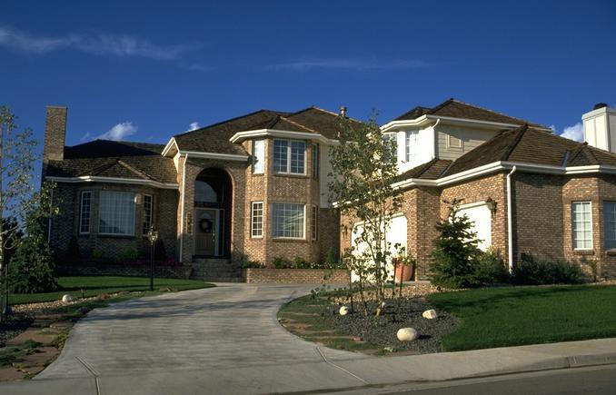
Architecting a house
Built most efficiently and timely by a team Requires
Modeling
Well-defined process Power tools
Software Systems Architecture Xiaobin Xu
15

Slide 8
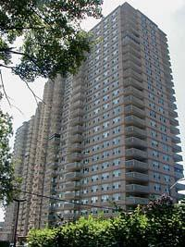
Architecting a high rise
Software Systems Architecture
Xiaobin Xu
16

Slide 9
Differences
Scale
Process
Cost
Schedule
Skills and development teams
Materials and technologies
Stakeholders
Risks
Software Systems Architecture
Xiaobin Xu
17

Slide 10
Definition of SA
The software architecture of a program or computing system is the structure or structures of the system, which comprise software elements, the externally visible properties of those elements, and the relationships among them.
----《Software Architecture in Practice》, Addison-
Wesley 1997
Architecture is the organizational structure of a system. An architecture can be recursively decomposed into parts that interact through interfaces, relationships that connect parts, and constraints for assembling parts. Parts that interact through interfaces include classes, components and subsystems.
----UML 1.3
Software Systems Architecture
Xiaobin Xu
18

Slide 11










Definition of SA
Software architecture is the fundamental organization of a system, embodied in its components, their relationships to each other and the environment, and the principles governing its design and evolution
----- IEEE 1471-2000
Software Systems Architecture
Xiaobin Xu
19

Slide 12
Definition of SA
Software Architecture
Software Elements: functions, Interfaces, programs, class modules, layers, subsystem, clients/servers etc.
Visible Properties: provided services, performance characteristics, fault handling, shared resource usage, and so on
Relations: composition mechanism and style of these elements
An architecture is the result of a set of business and technical decisions.
Software Systems Architecture
Xiaobin Xu
20

Slide 13
Definition of SSA
A Software Architecture Include:
the constituent elements ― Component
the interaction rules/mechanism ― Connector
So, it can be defined briefly as:
the components comprised in the system, and the relationships or
interaction mechanisms of those components.
Software Architecture Design = Decomposition + Composition
System
Composition
Decomposition
Components
Software Systems Architecture
Xiaobin Xu
21

Slide 14
Definition of SA
Decomposition/Composition
reducing the complexity of software design and construction.
controlling the risks of software development
improving the efficiency of organization and management
But, we must consider
How do we break the system down into pieces?
Do we have all the necessary pieces?
Do the pieces fit together?
Software Systems Architecture
Xiaobin Xu
22

Slide 15
Definition of SA
Hundreds of definitions on CMU web page: http://www.sei.cmu.edu/architecture/definitions.h tml
Software Systems Architecture
Xiaobin Xu
23

Slide 16
Related Concepts of SA
Component
A logical and functional unit of the system.
Note:
A component may be divided into more little unit of components.
A component serves certain responsibilities.
The component is an abstract and conceptual word, it’ll be different specific objects (for example, modules, subsystems, layers, packages, classes etc.) in different scenarios.
Software Systems Architecture
Xiaobin Xu
24

Slide 17


Related Concepts of SA
Connector
The interaction rules or mechanisms among components.
SA1:
SA3:
SA2:
Software Systems Architecture
Xiaobin Xu
25

Slide 18
Related Concepts of SA
Functional Property of the SA
the characters of the SA that meets the functional requirements.
Non-functional Property of the SA
the characters of the SA that meets the non- functional requirements. For example,
performance
portability
flexibility/extensibility
reliability/security
…
Software Systems Architecture
Xiaobin Xu
26

Slide 19
Related Concepts of SA
Framework
A framework is a reusable application infrastructure for a specified problems.
some necessary basic components for the specified problems
interaction mechanism and constraints among
components
a context or environment for the applications developed based on the framework
Commonly, a framework mainly presents a class library. For example: .NET Framework, JavaEE Framework etc.
Software Systems Architecture
Xiaobin Xu
27

Slide 20
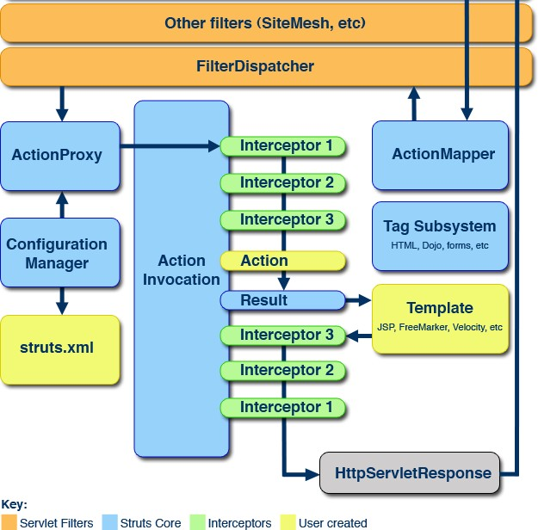
Architecture of Struts 2
Software Systems Architecture
Xiaobin Xu
28

Slide 21
Comments for SA
Architecture is at a high-enough level of abstraction
that the system can be viewed as a whole.
At the architectural level, all implementation details are hidden.
The architecture must support the functionality required of the system.
The architecture must conform to the system qualities (also known as non-functional requirements) : performance, security and reliability, flexibility or extensibility.
Software Systems Architecture
Xiaobin Xu
29

Slide 22
Where Do Architectures Come From?
Architectures are influenced by system
stakeholders.
Architectures are influenced by the developing organization.
Architectures are influenced by the background and experience of the architects.
Architectures are influenced by the
technical environment.
Software Systems Architecture
Xiaobin Xu
30

Slide 23
Architecture Business Cycle
Activities of architecture business cycle:
Creating the business case for the system
Understanding the requirements
Creating or selecting the architecture
Documenting and communicating the architecture
Analyzing or evaluating the architecture
Implementing the system based on the architecture
Ensuring that the implementation conforms to the architecture
Software Systems Architecture
Xiaobin Xu
35

Slide 24
The lifetime model of SA
SA
SA Information Description
Formalization Description
Termination
SA Provision, And Evaluation
SA Analysis
SA Specification
N
Is need Evolution or Extension?
SA Enactment
N
Is need
Verification or Refinement?
Y
Y
SA Evolution or
Extension
SA Verification
SA Refinement
Software Systems Architecture
Xiaobin Xu
36

Slide 25
Why Is Software Architecture Important?
Architecture is the vehicle for stakeholder
communication.
Architecture manifests the earliest set of design decisions.
The Architecture Defines Constraints on Implementation
The Architecture Dictates Organizational Structure
The Architecture Inhibits or Enables a System's Quality Attributes
Predicting System Qualities by Studying the Architecture
The Architecture Makes It Easier to Reason about and Manage Change
Software Systems Architecture
Xiaobin Xu
37

Slide 26
Why Is Software Architecture Important?
The Architecture Helps in Evolutionary Prototyping
The Architecture Enables More Accurate Cost and Schedule Estimates
Architecture as a transferable, re-usable model.
Software Product Lines Share a Common Architecture
Systems Can Be Built Using Large, Externally Developed Elements
Software Systems Architecture
Xiaobin Xu
38

Slide 27
Values of Architecture
Architecture serves both technical and organizational purposes:
Organization side:
Communicating inside organization, and between customers and vendors
Providing the high-level information of
systems costs and risks evaluating
Work allocation and project schedule
Software Systems Architecture
Xiaobin Xu
39

Slide 28
Values of Architecture
Technical side:
meet system requirements and objectives
Specify the constraints of detailed design, construction and testing phrase
enable flexible distribution/partitioning of the system
reduce cost of maintenance and evolution
increase reuse and integrate with legacy and third party software
Software Systems Architecture
Xiaobin Xu
40

Slide 29
Who focus on Software Architecture?
An architectural view is a simplified description (an abstraction) of a system from a particular perspective or vantage point, covering particular concerns, and omitting entities that are not relevant to this perspective
Software Systems Architecture
Xiaobin Xu
4

Slide 30
About Kruchten and this paper
Philippe Kruchten
Over 16 years of experience as the leader of RUP development team in Rational corp. (now owned by IBM)
Valuable experiences in industry (Telecom, Air traffic control system) which he used them for confirmation of his model
The “4+1 view model” paper:
60 citations according to ACM portal site
Software Systems Architecture
Xiaobin Xu
3

Slide 31
Problem
Arch. documents over-emphasize an aspect of development (i.e. team organization) or do not address the concerns of all stakeholders
Various stakeholders of software system: end-user, developers, system engineers, project managers
Software engineers struggled to represent more on one blueprint, and so arch. documents contain complex diagrams
Software Systems Architecture
Xiaobin Xu
5

Slide 32
Solution
Using several concurrent views or perspectives, with different notations each one addressing one specific set for concerns
“4+1” view model presented to address large and challenging architectures
Software Systems Architecture
Xiaobin Xu
6

Slide 33








4+1 View Model of Architecture
End user
Development view
Programmers & software managers
Logical view
Scenarios
Process View
Physical View
Integrator
System Engineer
Software Systems Architecture
Xiaobin Xu
7

Slide 34
Characteristics of a Good Architecture
Resilient
Simple
Approachable
Clear separation of concerns
Balanced distribution of responsibilities
Balances economic and technology constraints
Software Systems Architecture
Xiaobin Xu
41

Slide 35
Research of SA
Formalization Research
refers to how to describe the SA in specific rules how to view and present the SA
ADL--- Architecture Description Language
Verification & Evaluation Research
refers to how to verify and evaluate the SA whether it meets the constraints of functional and non-functional requirement.
ATAM---Architecture Tradeoff Analysis Method
Software Systems Architecture
Xiaobin Xu
42

Slide 36
Assignment1
Select a research hotspot related with Software
Architecture.
Tasks: Do extensive reading & Write a paper or report.
Software Systems Architecture
Xiaobin Xu
43

